Slide 1

Heaven’s light is our guide”
Rajshahi University of Engineering & Technology
Department of Computer Science & Engineering
Data Communication
Course No. : CSE 3103
Chapter 4: Digital Transmission
Prepared By : Julia Rahman

Slide 2
4-1 DIGITAL-TO-DIGITAL CONVERSION
We can represent digital data by using digital signals.
The conversion involves three techniques:
line coding,
block coding, and
scrambling.
Line coding is always needed;
Block coding and scrambling may or may not be needed.

Slide 3
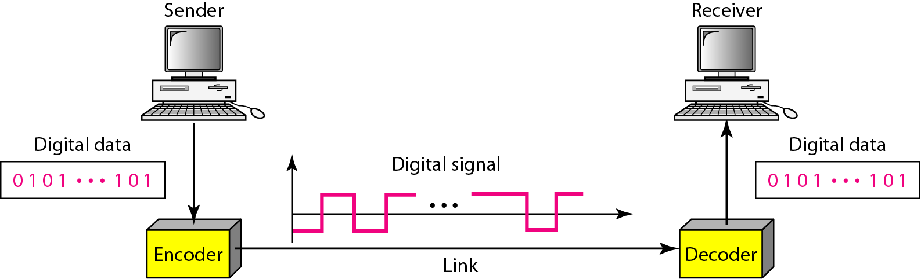
4-1 DIGITAL-TO-DIGITAL CONVERSION
Line Coding
The process of converting digital data to digital signals
Digital data – sequences of bits
Converting a string of 1’s and 0’s (digital data) into a sequence of signals that denote the 1’s and 0’s.
For example a high voltage level (+V) could represent a “1” and a low voltage level (0 or -V) could represent a “0”.
Figure 4.1 Line coding and decoding

Slide 4
4-1 DIGITAL-TO-DIGITAL CONVERSION
Mapping Data symbols onto Signal levels
A data symbol (or element) can consist of a number of data bits:
1 , 0 or
11, 10, 01, ……
A data symbol can be coded into a single signal element or multiple signal elements
1 → +V, 0 → -V
1 → +V and -V, 0 → -V and +V
The ratio ‘r’ is the number of data elements carried by a signal element

Slide 5
4-1 DIGITAL-TO-DIGITAL CONVERSION
Characteristics of Line Coding
Signal element vs. data element
A signal element is the shortest time unit of a digital signal.
Data elements are what to need to send as information.
Data rate vs. signal rate
Data rate (bit rate) – the number of data elements in a unit time (bps).
Signal rate (pulse, modulation rate, baud rate) – the number of signal element in a unit time (baud).
Goal is to increase the data rate whilst reducing the baud rate.
Bandwidth
Actual bandwidth of a digital signal is infinite, the effective bandwidth is finite.

Slide 6
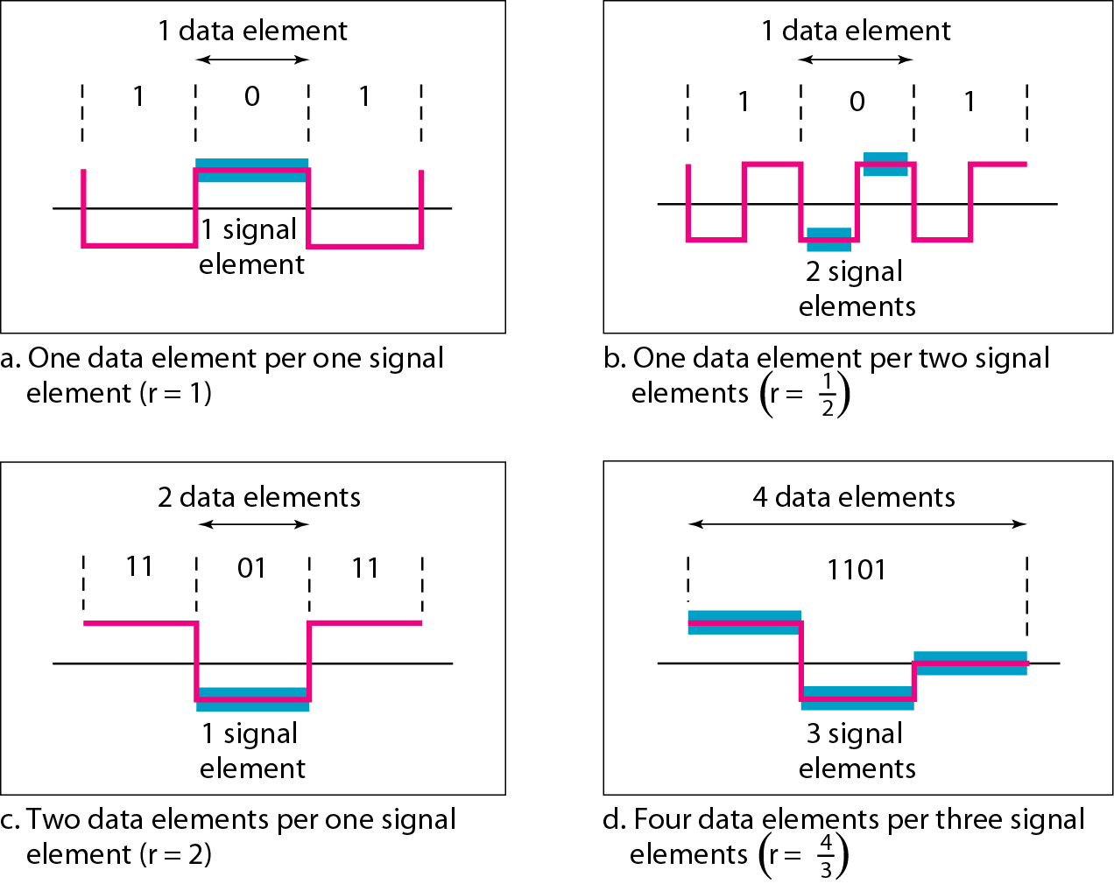
4-1 DIGITAL-TO-DIGITAL CONVERSION
Characteristics of Line Coding (cont.)

Slide 7
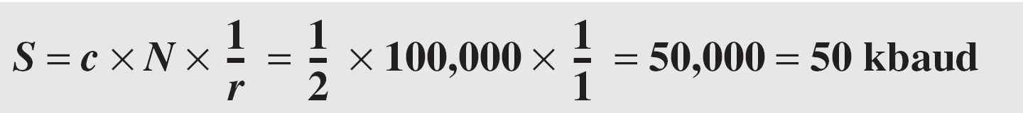
4-1 DIGITAL-TO-DIGITAL CONVERSION
Data rate and Baud rate
The baud or signal rate can be expressed as:
S = c x N x 1/r bauds
where N is data rate
c is the case factor (worst, best & avg.)
r is the ratio between data element & signal element
Example 4.1: A signal is carrying data in which one data element is encoded as one signal element ( r = 1). If the bit rate is 100 kbps, what is the average value of the baud rate if c is between 0 and 1?
Solution: We assume that the average value of c is 1/2 . The baud rate is then

Slide 8
4-1 DIGITAL-TO-DIGITAL CONVERSION
Considerations for choosing a good signal element referred to as line encoding
Baseline wandering –
A receiver will evaluate the average power of the received signal (called the baseline) and use that to determine the value of the incoming data elements.
If the incoming signal does not vary over a long period of time, the baseline will drift and thus cause errors in detection of incoming data elements.
A good line encoding scheme will prevent long runs of fixed amplitude.

Slide 9
4-1 DIGITAL-TO-DIGITAL CONVERSION
Considerations for choosing a good signal element referred to as line encoding (cont.)
DC components –
When the voltage level remains constant for long periods of time, there is an increase in the low frequencies of the signal.
Most channels are band pass and may not support the low frequencies.
This will require the removal of the dc component of a transmitted signal.

Slide 10
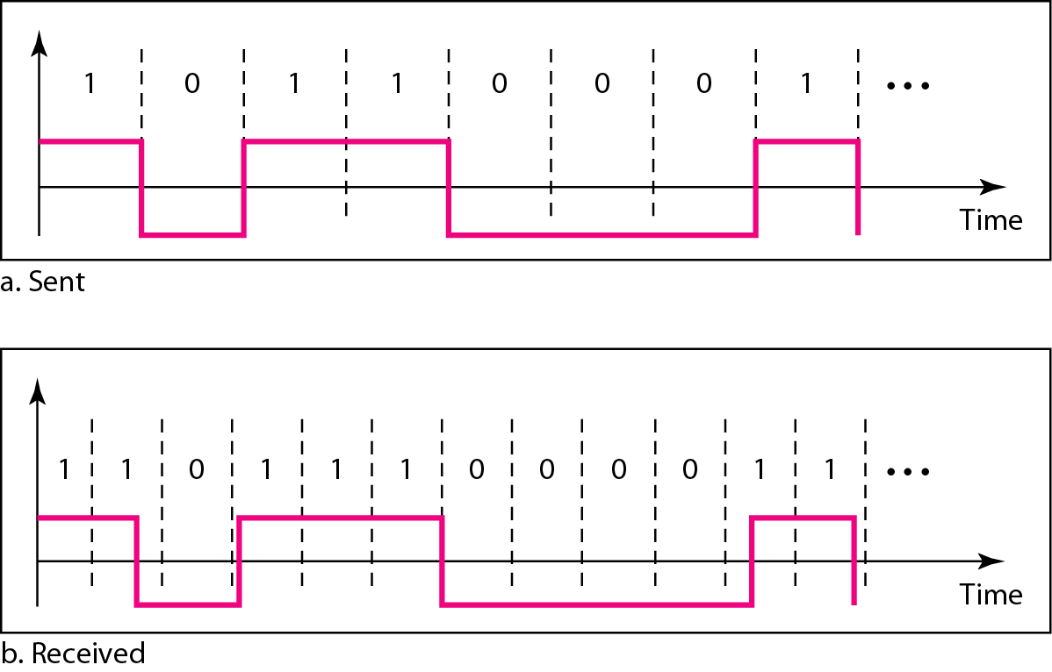
4-1 DIGITAL-TO-DIGITAL CONVERSION
Considerations for choosing a good signal element referred to as line encoding (cont.)
Self synchronization –
The clocks at the sender and the receiver must have the same bit interval.
If the receiver clock is faster or slower it will misinterpret the incoming bit stream.
Figure 4.3 Effect of lack of synchronization

Slide 11
4-1 DIGITAL-TO-DIGITAL CONVERSION
Considerations for choosing a good signal element referred to as line encoding (cont.)
Error detection –
Errors occur during transmission due to line impairments.
For example: a particular signal transition is not part of the code. When it occurs, the receiver will know that a symbol error has occurred.
Noise and interference –
There are line encoding techniques that make the transmitted signal “immune” to noise and interference.
Complexity - the more robust and resilient the code, the more complex it is to implement and the price is often paid in baud rate or required bandwidth.

Slide 12
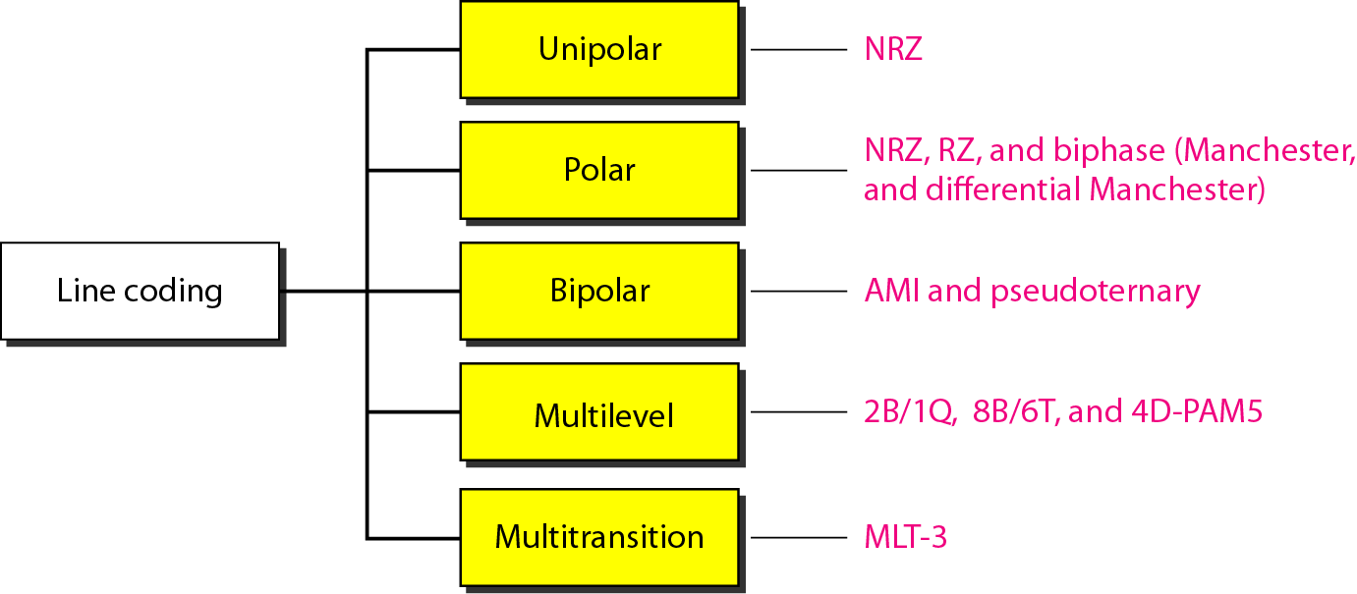
4-1 DIGITAL-TO-DIGITAL CONVERSION
Line Coding Schemes

Slide 13
4-1 DIGITAL-TO-DIGITAL CONVERSION
Unipolar
All signal levels are on one side of the time axis - either above or below
NRZ - Non Return to Zero scheme is an example of this code. The signal level does not return to zero during a symbol transmission.
Scheme is prone to baseline wandering and DC components.
It has no synchronization or any error detection.
It is simple but costly in power consumption.

Slide 14
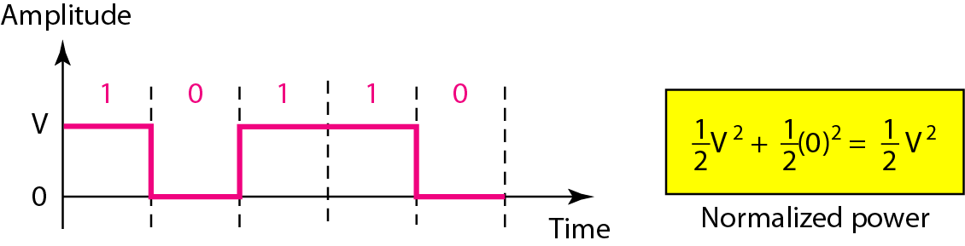
4-1 DIGITAL-TO-DIGITAL CONVERSION
Unipolar (cont.)
Figure 4.5 Unipolar NRZ scheme

Slide 15
4-1 DIGITAL-TO-DIGITAL CONVERSION
Polar – NRZ
The voltages are on both sides of the time axis.
Polar NRZ scheme can be implemented with two voltages. E.g. +V for 1 and -V for 0.
There are two versions:
NZR - Level (NRZ-L) - positive voltage for one symbol and negative for the other
NRZ - Inversion (NRZ-I) - the change or lack of change in polarity determines the value of a symbol. E.g. a “1” symbol inverts the polarity a “0” does not.

Slide 16
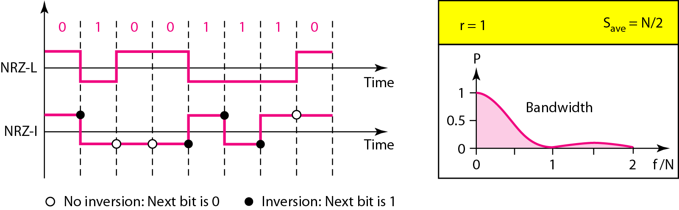
4-1 DIGITAL-TO-DIGITAL CONVERSION
Polar – NRZ (cont.)
Figure 4.6 Polar NRZ-L and NRZ-I schemes

Slide 17
4-1 DIGITAL-TO-DIGITAL CONVERSION
Polar – NRZ (cont.)
In NRZ-L the level of the voltage determines the value of the bit.
In NRZ-I the inversion or the lack of inversion determines the value of the bit.
NRZ-L and NRZ-I both have an average signal rate of N/2 Bd.
NRZ-L and NRZ-I both have a DC component problem and baseline wandering, it is worse for NRZ-L.
Both have no self synchronization & no error detection.
Both are relatively simple to implement.

Slide 18
4-1 DIGITAL-TO-DIGITAL CONVERSION
Polar – RZ
The Return to Zero (RZ) scheme uses three voltage values. +, 0, -.
Each symbol has a transition in the middle. Either from high to zero or from low to zero.
This scheme has more signal transitions (two per symbol) and therefore requires a wider bandwidth.
No DC components or baseline wandering.
Self synchronization - transition indicates symbol value.
More complex as it uses three voltage level.
It has no error detection capability.

Slide 19
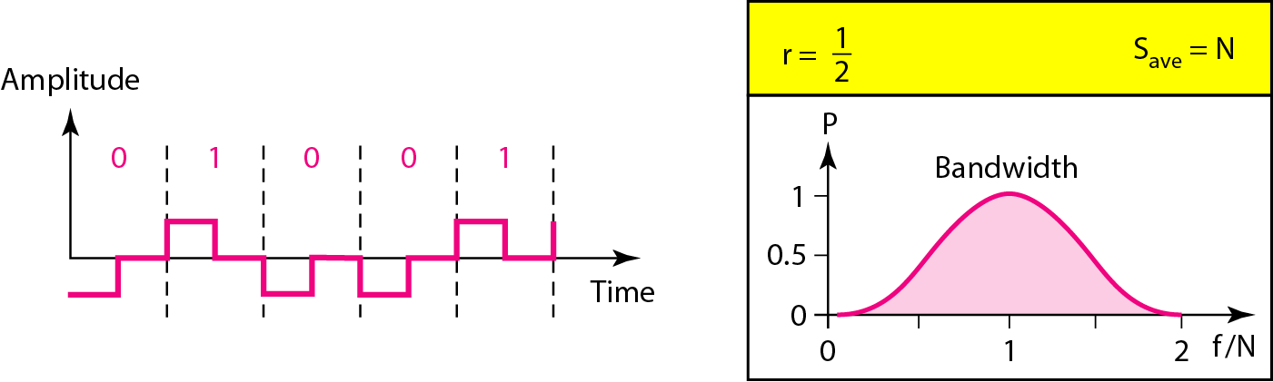
4-1 DIGITAL-TO-DIGITAL CONVERSION
Polar – RZ (cont.)
Figure 4.7 Polar RZ scheme

Slide 20
4-1 DIGITAL-TO-DIGITAL CONVERSION
Polar – Biphase
Manchester coding consists of combining the NRZ-L and RZ schemes.
Every symbol has a level transition in the middle: from high to low or low to high. Uses only two voltage levels.
Differential Manchester coding consists of combining the NRZ-I and RZ schemes.
Every symbol has a level transition in the middle. But the level at the beginning of the symbol is determined by the symbol value. One symbol causes a level change the other does not.

Slide 21
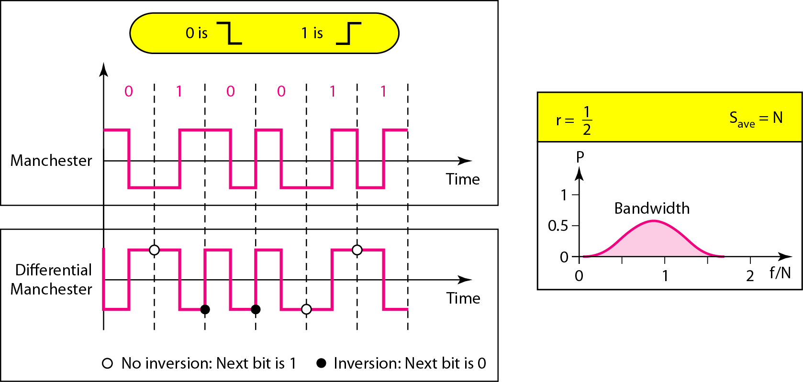
4-1 DIGITAL-TO-DIGITAL CONVERSION
Polar – Biphase (cont.)
Figure 4.8 Polar biphase: Manchester and differential Manchester schemes

Slide 22
4-1 DIGITAL-TO-DIGITAL CONVERSION
Polar – Biphase (cont.)
In Manchester and differential Manchester encoding, the transition at the middle of the bit is used for synchronization.
The minimum bandwidth of Manchester and differential Manchester is 2 times that of NRZ.
The is no DC component and no baseline wandering. None of these codes has error detection.

Slide 23
4-1 DIGITAL-TO-DIGITAL CONVERSION
Bipolar - AMI and Pseudoternary
Code uses 3 voltage levels: - +, 0, -, to represent the symbols (note not transitions to zero as in RZ).
Voltage level for one symbol is at “0” and the other alternates between + & -.
Bipolar Alternate Mark Inversion (AMI) - the “0” symbol is represented by zero voltage and the “1” symbol alternates between +V and -V.
Pseudoternary is the reverse of AMI.

Slide 24
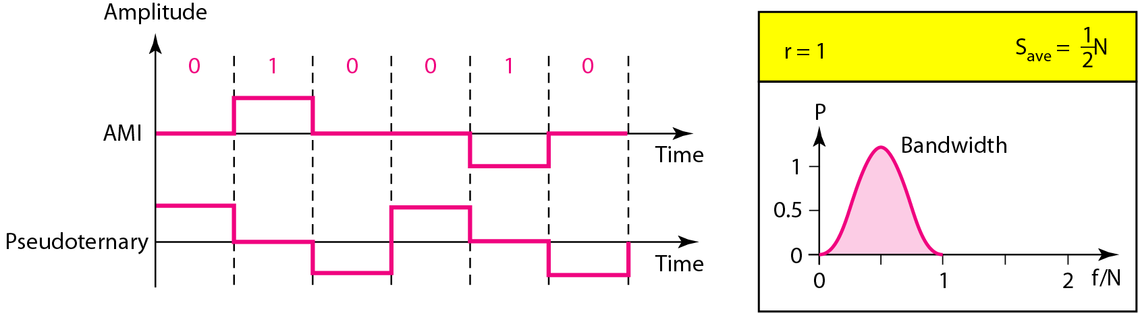
4-1 DIGITAL-TO-DIGITAL CONVERSION
Bipolar - AMI and Pseudoternary (cont.)
Figure 4.9 Bipolar schemes: AMI and pseudoternary

Slide 25
4-1 DIGITAL-TO-DIGITAL CONVERSION
Block Coding
For a code to be capable of error detection, we need to add redundancy, i.e., extra bits to the data bits.
Synchronization also requires redundancy - transitions are important in the signal flow and must occur frequently.
Block coding is done in three steps: division, substitution and combination.
It is distinguished from multilevel coding by use of the slash - xB/yB.
The resulting bit stream prevents certain bit combinations that when used with line encoding would result in DC components or poor sync. quality.
Block coding is normally referred to as mB/nB coding; it replaces each m-bit group with an n-bit group.

Slide 26
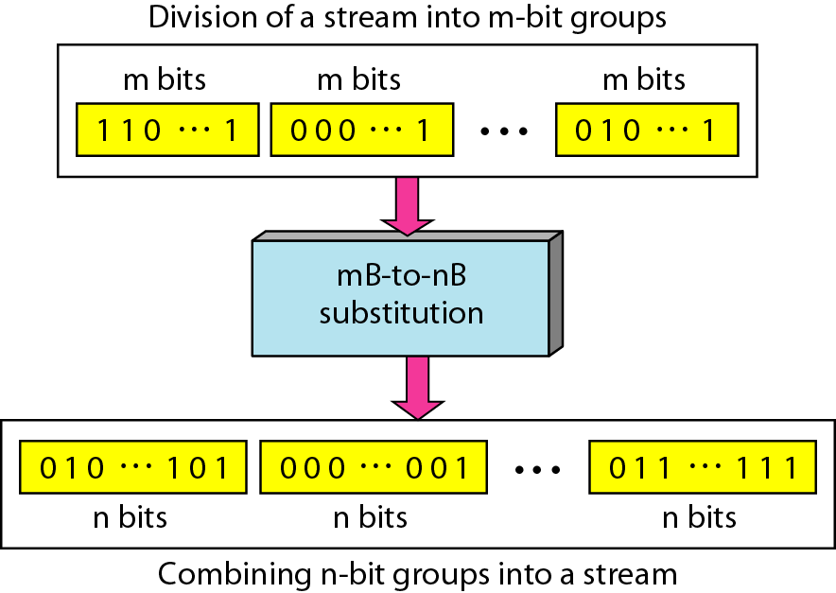
4-1 DIGITAL-TO-DIGITAL CONVERSION
Block Coding (cont.)
Figure 4.14 Block coding concept

Slide 27
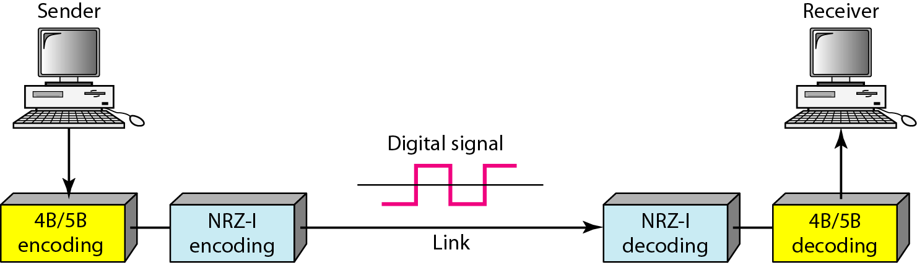
4-1 DIGITAL-TO-DIGITAL CONVERSION
Block Coding (cont.)
Figure 4.15 Using block coding 4B/5B with NRZ-I line coding scheme

Slide 28
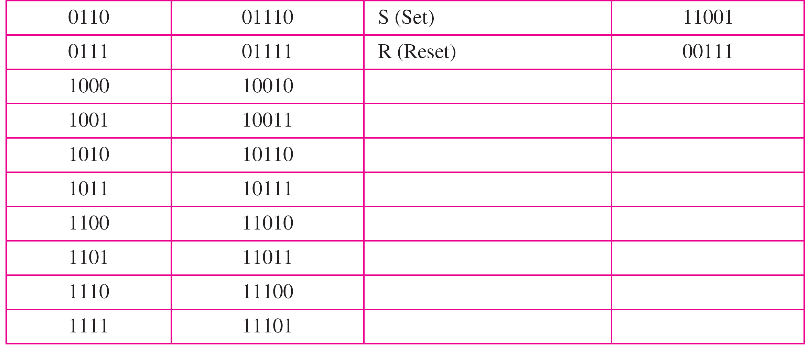
4-1 DIGITAL-TO-DIGITAL CONVERSION
Block Coding (cont.)
Table 4.2 4B/5B mapping codes

Slide 29
4-1 DIGITAL-TO-DIGITAL CONVERSION
Scrambling
The best code is one that does not increase the bandwidth for synchronization and has no DC components.
Scrambling is a technique used to create a sequence of bits that has the required c/c’s for transmission - self clocking, no low frequencies, no wide bandwidth.
It is implemented at the same time as encoding, the bit stream is created on the fly.
It replaces ‘unfriendly’ runs of bits with a violation code that is easy to recognize and removes the unfriendly c/c.

Slide 30
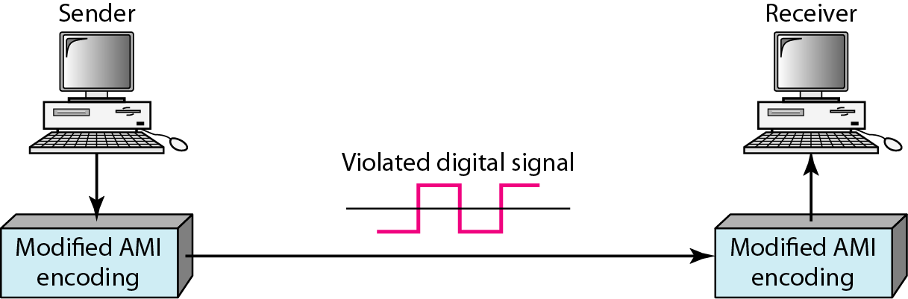
4-1 DIGITAL-TO-DIGITAL CONVERSION
Scrambling (cont.)
Figure 4.18 AMI used with scrambling

Slide 31
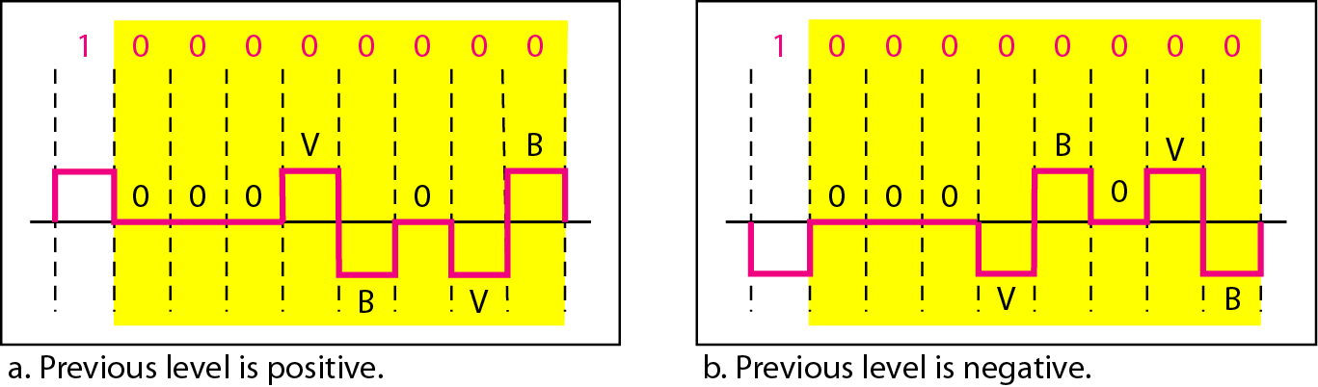
4-1 DIGITAL-TO-DIGITAL CONVERSION
Scrambling (cont.)
For example: B8ZS substitutes eight consecutive zeros with 000VB0VB.
The V stands for violation, it violates the line encoding rule
B stands for bipolar, it implements the bipolar line encoding rule
Figure 4.19 Two cases of B8ZS scrambling technique

Slide 32
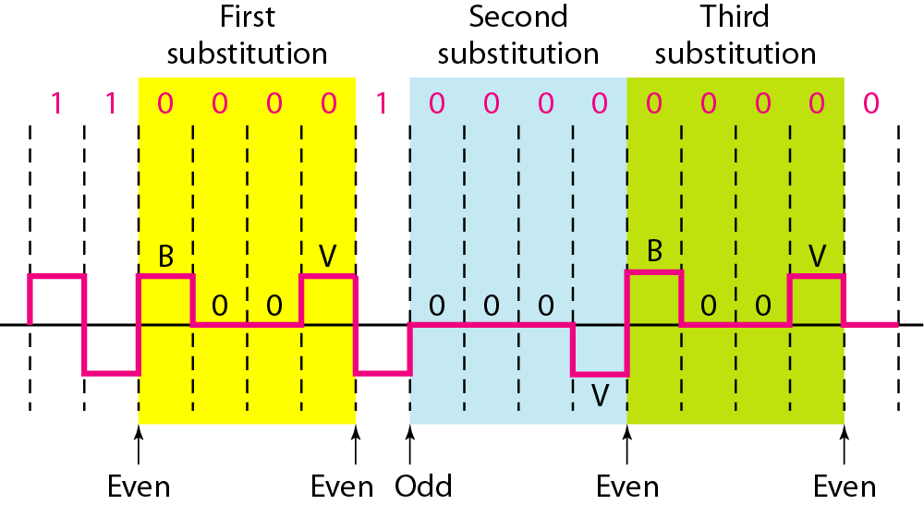
4-1 DIGITAL-TO-DIGITAL CONVERSION
Scrambling (cont.)
HDB3 substitutes four consecutive zeros with 000V or B00V depending on the number of nonzero pulses after the last substitution.
If number of non zero pulses is even the substitution is B00V to make total number of non zero pulse even.
If number of non zero pulses is odd the substitution is 000V to make total number of non zero pulses even.
Figure 4.20 Different situations in HDB3 scrambling technique

Slide 33
4-2 ANALOG-TO-DIGITAL CONVERSION
A digital signal is superior to an analog signal because it is more robust to noise and can easily be recovered, corrected and amplified.
Example: Voice is converted to a digital stream by a phone then converted to an analog signal representing digital data.
For this reason, the tendency today is to change an analog signal to digital data.
In this section we describe two techniques, pulse code modulation and delta modulation.
Pulse Code Modulation (PCM)
Delta Modulation (DM)

Slide 34
4-2 ANALOG-TO-DIGITAL CONVERSION
Pulse Code Modulation (PCM)
The most common technique to change an analog signal to digital data (digitization) is called pulse code modulation (PCM).
A PCM encoder has three steps:
Sampling
Quantizing
Encoding
Before we sample, we have to filter the signal to limit the maximum frequency of the signal as it affects the sampling rate.
Filtering should ensure that we do not distort the signal, i.e. remove high frequency components that affect the signal shape.

Slide 35
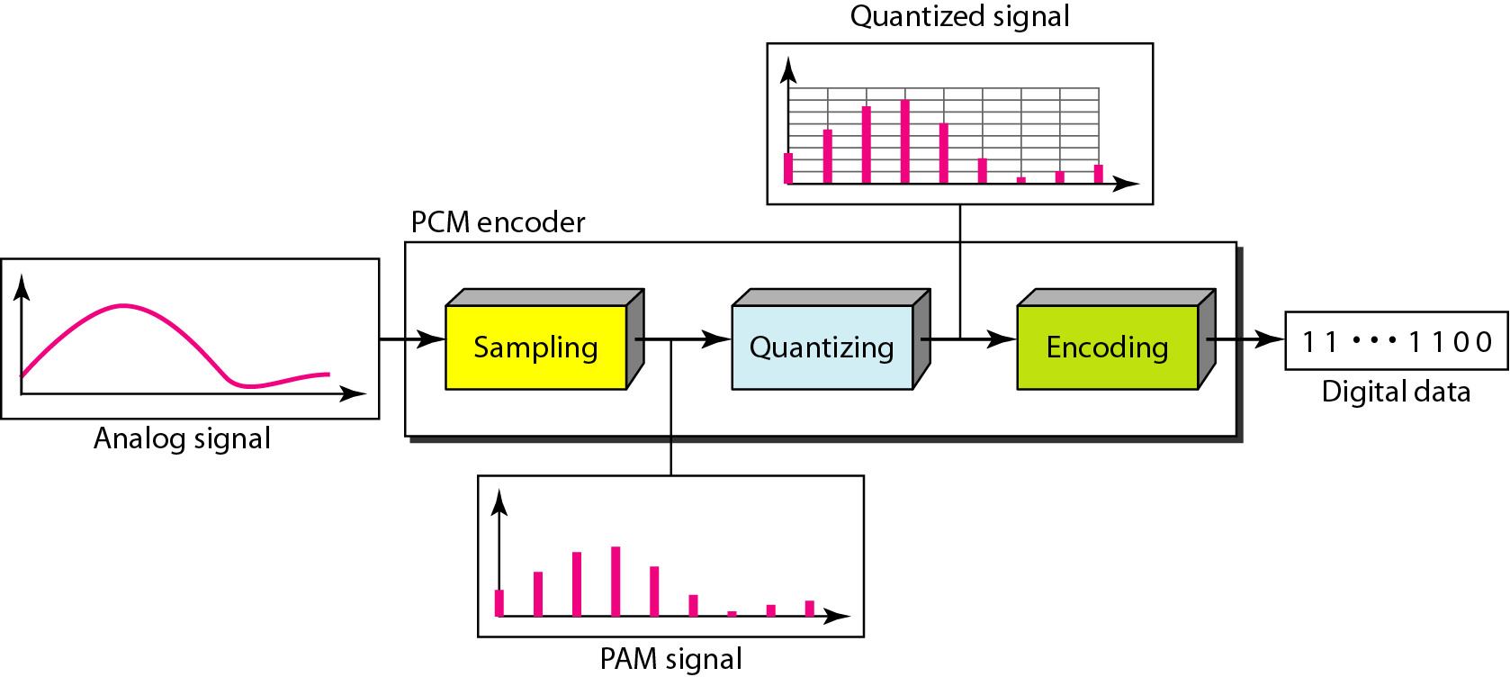
4-2 ANALOG-TO-DIGITAL CONVERSION
Pulse Code Modulation (cont.)
Figure 4.21 Components of PCM encoder

Slide 36
4-2 ANALOG-TO-DIGITAL CONVERSION
Pulse Code Modulation: Sampling
Analog signal is sampled every T_{S} seconds.
T_{S} is referred to as the sampling interval.
f_{s} = 1/T_{s} is called the sampling rate or sampling frequency.
There are 3 sampling methods:
Ideal - an impulse at each sampling instant
Natural - a pulse of short width with varying amplitude
Flattop - sample and hold, like natural but with single amplitude value
The process is referred to as pulse amplitude modulation PAM and the outcome is a signal with analog (non integer) values

Slide 37
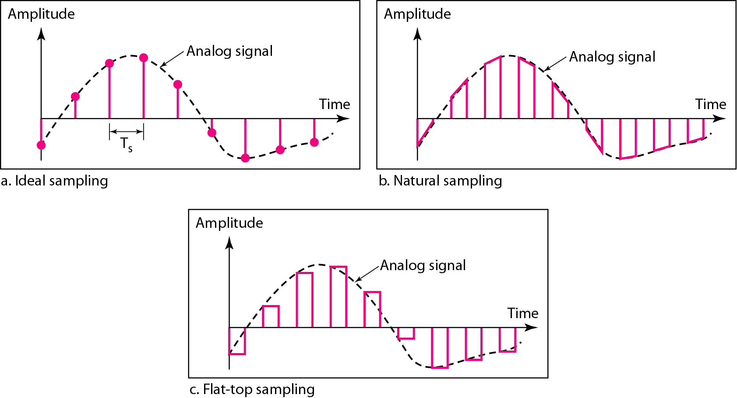
4-2 ANALOG-TO-DIGITAL CONVERSION
Pulse Code Modulation: Sampling (cont.)
Figure 4.22 Three different sampling methods for PCM

Slide 38
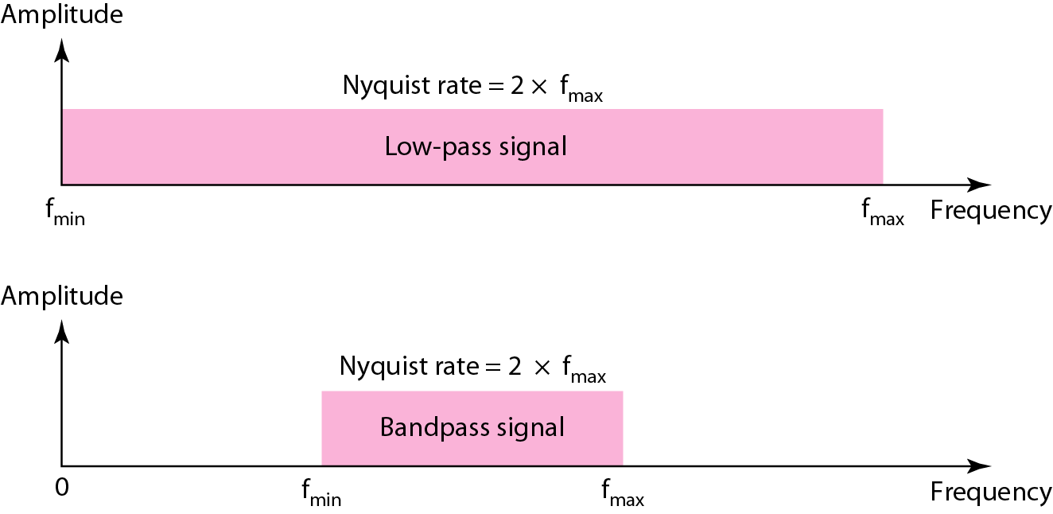
4-2 ANALOG-TO-DIGITAL CONVERSION
Pulse Code Modulation: Sampling (cont.)
According to the Nyquist theorem, the sampling rate must be at least 2 times the highest frequency contained in the signal.
To reproduce the original analog signal, one necessary condition is Nyquist theorem.

Slide 39
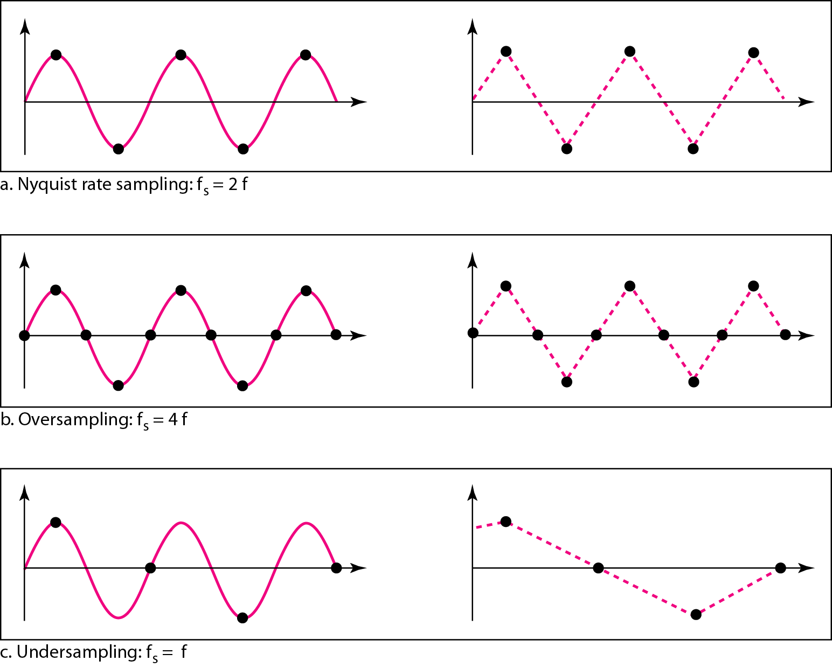
4-2 ANALOG-TO-DIGITAL CONVERSION
Pulse Code Modulation: Sampling (cont.)
Figure 4.24 Recovery of a sampled sine wave for different sampling rates

Slide 40
4-2 ANALOG-TO-DIGITAL CONVERSION
Pulse Code Modulation: Quantization
Sampling results in a series of pulses of varying amplitude values ranging between two limits: a min and a max.
The amplitude values are infinite between the two limits.
We need to map the infinite amplitude values onto a finite set of known values.
This is achieved by dividing the distance between min and max into L zones, each of height Δ
Δ = (max - min)/L
Quantization Levels –
The midpoint of each zone is assigned a value from 0 to L-1 (resulting in L values)
Each sample falling in a zone is then approximated to the value of the midpoint.

Slide 41
4-2 ANALOG-TO-DIGITAL CONVERSION
Pulse Code Modulation: Quantization (cont.)
Quantization Zones –
Assume we have a voltage signal with amplitutes V_{min}=-20V and V_{max}=+20V.
We want to use L=8 quantization levels.
Zone width Δ = (20 - 20)/8 = 5
The 8 zones are: -20 to -15, -15 to -10, -10 to -5, -5 to 0, 0 to +5, +5 to +10, +10 to +15, +15 to +20
The midpoints are: -17.5, -12.5, -7.5, -2.5, 2.5, 7.5, 12.5, 17.5
Each zone is then assigned a binary code.
The number of bits required to encode the zones, or the number of bits per sample as it is commonly referred to, is obtained as follows:
n_{b} = log₂ L

Slide 42
4-2 ANALOG-TO-DIGITAL CONVERSION
Pulse Code Modulation: Quantization (cont.)
Quantization Zones –
Given our example, n_{b} = 3
The 8 zone (or level) codes are therefore: 000, 001, 010, 011, 100, 101, 110, and 111
Assigning codes to zones:
000 will refer to zone -20 to -15
001 to zone -15 to -10, etc.

Slide 43
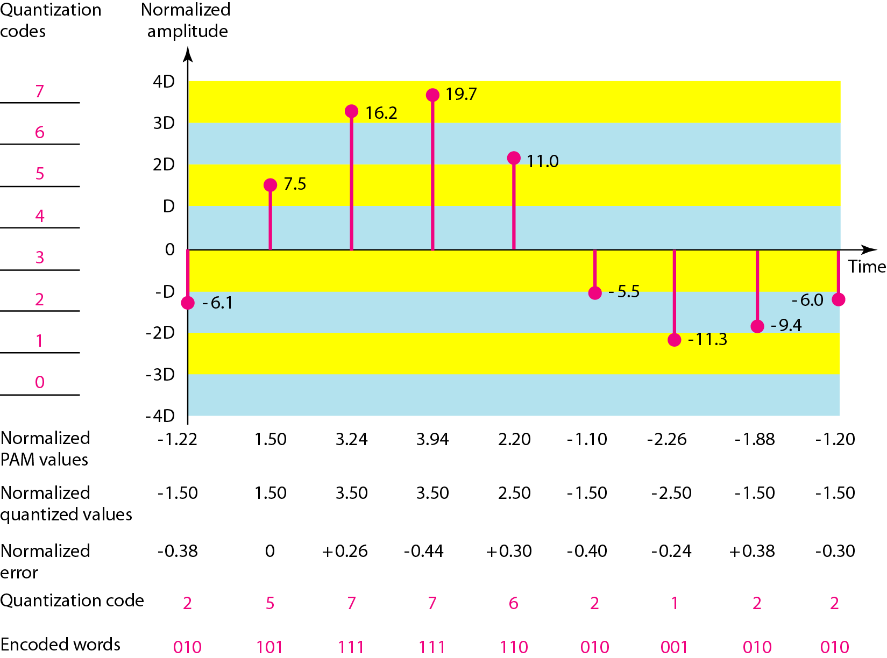
4-2 ANALOG-TO-DIGITAL CONVERSION
Pulse Code Modulation: Quantization (cont.)
Figure 4.26 Quantization and encoding of a sampled signal

Slide 44
4-2 ANALOG-TO-DIGITAL CONVERSION
Pulse Code Modulation: Quantization (cont.)
Quantization Error –
When a signal is quantized, we introduce an error - the coded signal is an approximation of the actual amplitude value.
The difference between actual and coded value (midpoint) is referred to as the quantization error.
The more zones, the smaller Δ which results in smaller errors.
BUT, the more zones the more bits required to encode the samples → higher bit rate
Bit rate and bandwidth requirements of PCM –
The bit rate of a PCM signal can be calculated form the number of bits per sample x the sampling rate
Bit rate = n_{b} x f_{s}

Slide 45
4-2 ANALOG-TO-DIGITAL CONVERSION
PCM Decoder
To recover an analog signal from a digitized signal we follow the following steps –
We use a hold circuit that holds the amplitude value of a pulse till the next pulse arrives.
We pass this signal through a low pass filter with a cutoff frequency that is equal to the highest frequency in the pre-sampled signal.
The higher the value of L, the less distorted a signal is recovered

Slide 46
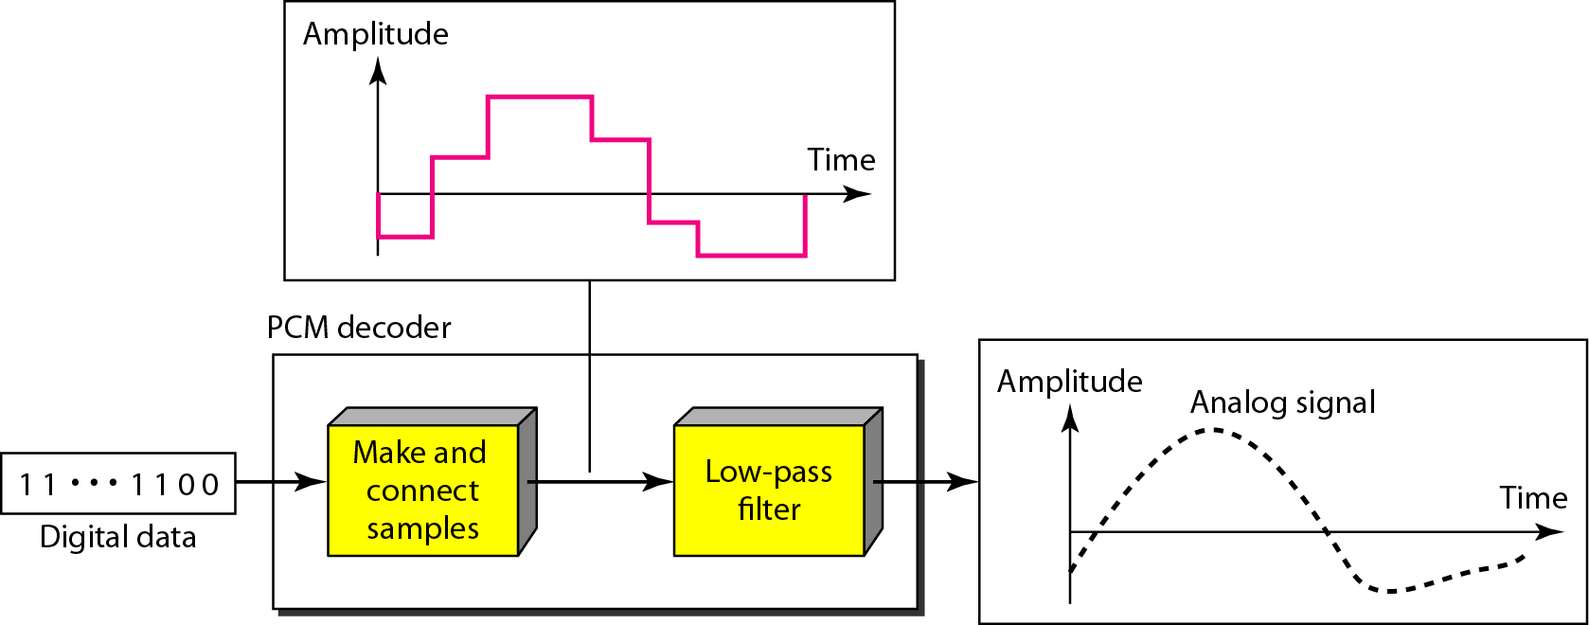
4-2 ANALOG-TO-DIGITAL CONVERSION
PCM Decoder (cont.)
Figure 4.27 Components of a PCM decoder

Slide 47
4-2 ANALOG-TO-DIGITAL CONVERSION
Delta Modulation
This scheme sends only the difference between pulses, if the pulse at time t_{n+1} is higher in amplitude value than the pulse at time t_{n}, then a single bit, say a “1”, is used to indicate the positive value.
If the pulse is lower in value, resulting in a negative value, a “0” is used.
This scheme works well for small changes in signal values between samples.
If changes in amplitude are large, this will result in large errors.

Slide 48
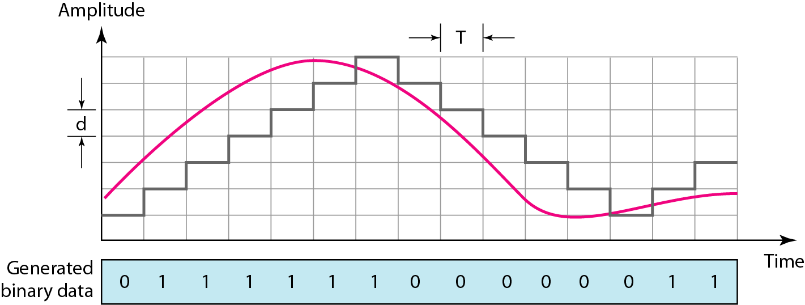
4-2 ANALOG-TO-DIGITAL CONVERSION
Delta Modulation (cont.)
Figure 4.28 The process of delta modulation

Slide 49
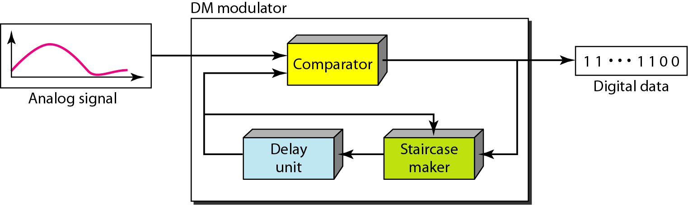
4-2 ANALOG-TO-DIGITAL CONVERSION
Delta Modulation (cont.)
Figure 4.29 Delta modulation components

Slide 50
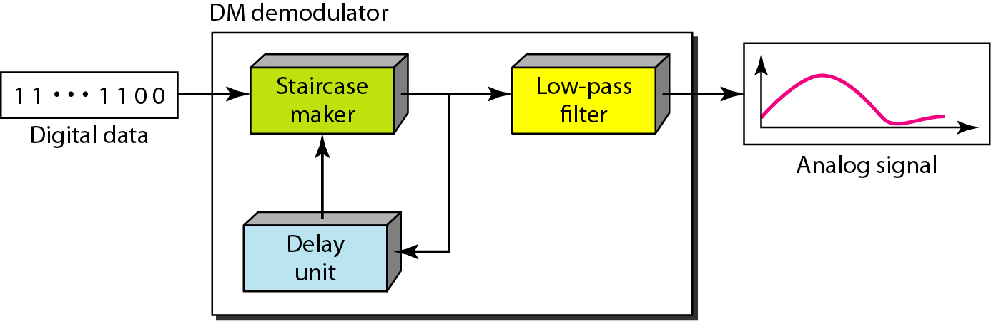
4-2 ANALOG-TO-DIGITAL CONVERSION
Delta Modulation (cont.)
Figure 4.30 Delta demodulation components

Slide 51
4-3 TRANSMISSION MODES
The transmission of binary data across a link can be accomplished in either parallel or serial mode.
In parallel mode, multiple bits are sent with each clock tick. In serial mode, 1 bit is sent with each clock tick.
While there is only one way to send parallel data, there are three subclasses of serial transmission: asynchronous, synchronous, and isochronous.
In this section we describe two techniques:
Parallel Transmission
Serial Transmission

Slide 52
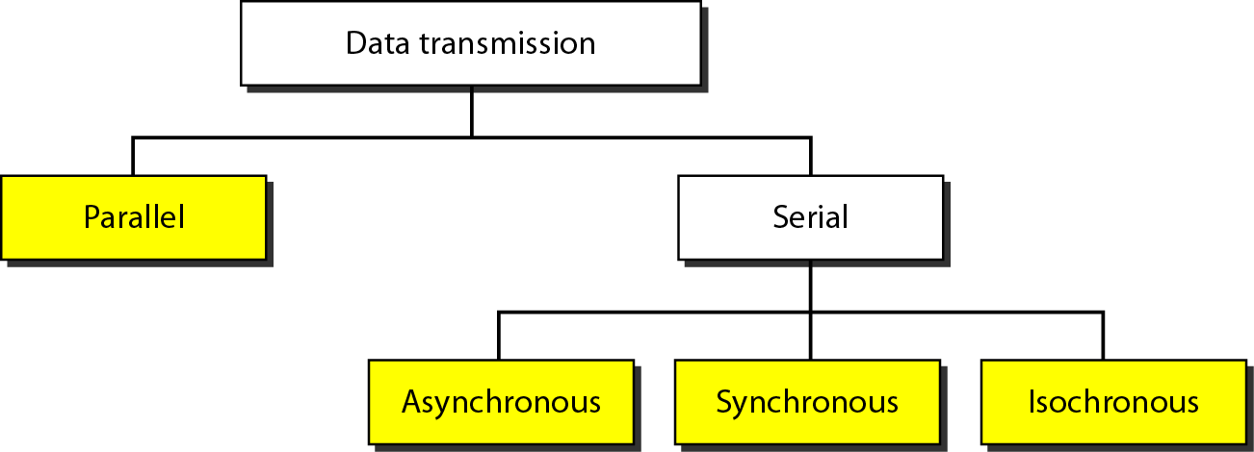
4-3 TRANSMISSION MODES
Figure 4.31 Data transmission and modes

Slide 53
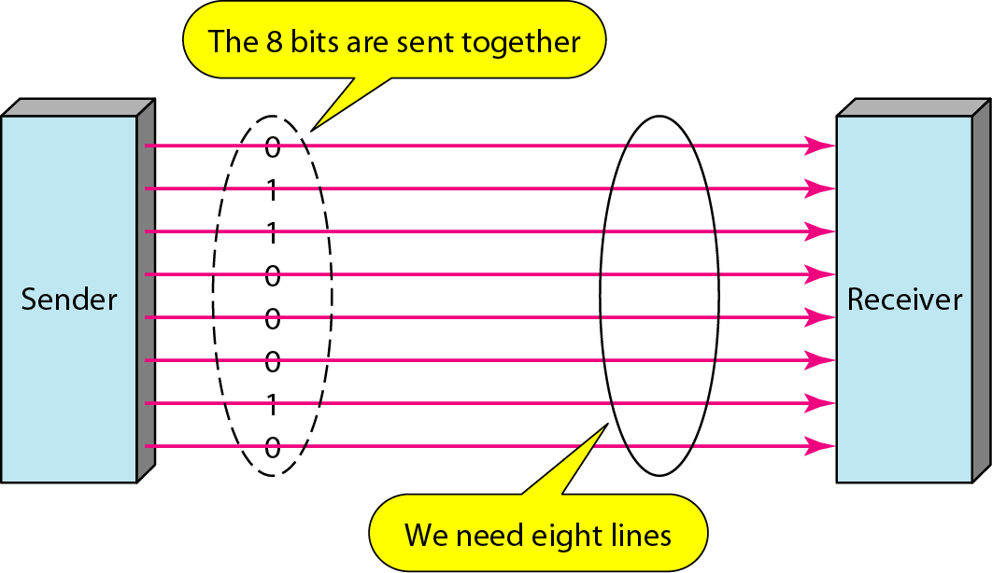
4-3 TRANSMISSION MODES
Figure 4.32 Parallel transmission

Slide 54
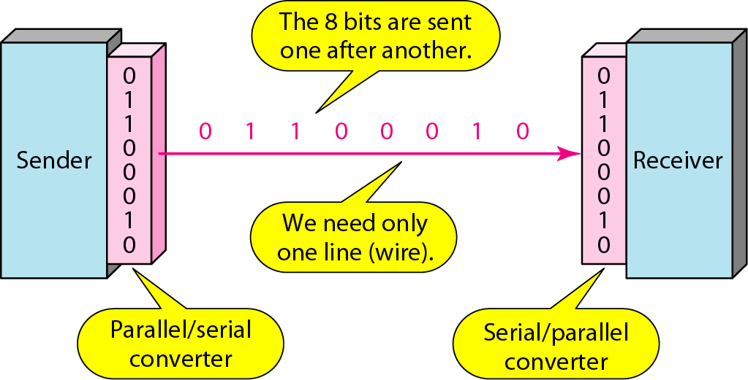
4-3 TRANSMISSION MODES
Figure 4.33 Serial transmission

Slide 55
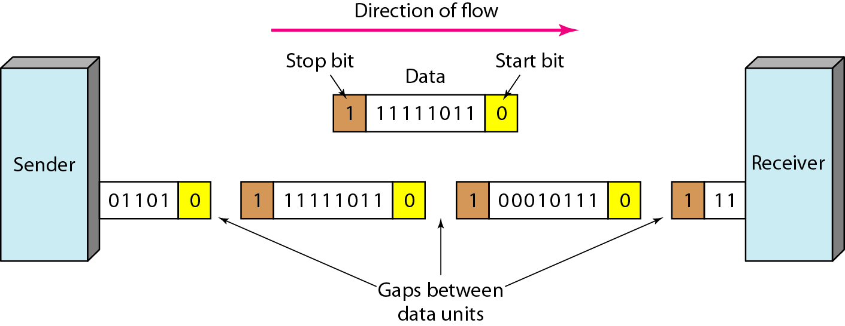
4-3 TRANSMISSION MODES
In asynchronous transmission, we send 1 start bit (0) at the beginning and 1 or more stop bits (1s) at the end of each byte.
There may be a gap between each byte.
Asynchronous here means “asynchronous at the byte level,” but the bits are still synchronized; their durations are the same.

Slide 56
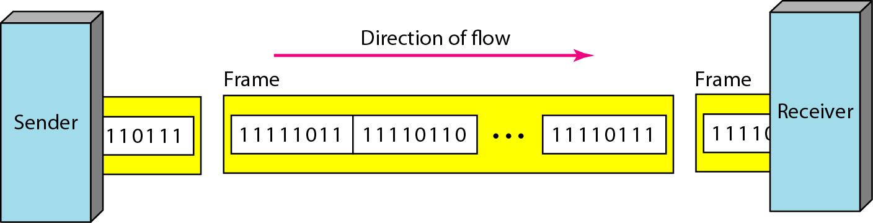
4-3 TRANSMISSION MODES
In synchronous transmission, we send bits one after another without start or stop bits or gaps.
It is the responsibility of the receiver to group the bits.
The bits are usually sent as bytes and many bytes are grouped in a frame.
A frame is identified with a start and an end byte.

Slide 57
4-3 TRANSMISSION MODES
In isochronous transmission we cannot have uneven gaps between frames.
Transmission of bits is fixed with equal gaps.

